Slide 1
Changes in Our local area- Maleny/ Mary caincross
Year 3 History

Slide 2
Our Local Area: Beerwah to Maleny.
What natural features in our local area have been lost?
What features have been retained?

Slide 3
Felling giant fig in dense rainforest 1908

Slide 4
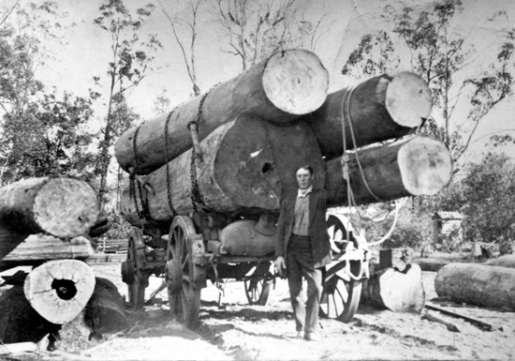
Main Title: Alec Hume with loaded bullock wagon, Maleny, ca 1916 [picture]
Alec Hume with loaded bullock wagon, Maleny, ca 1916 [picture]

Slide 5
Bullock team crossing Obi Obi creek at Maleny 1914

Slide 6
Bald knob 1925
Notes:
(more trees than today )

Slide 7
Construction of Baroon Pocket Dam

Slide 8
Bullock team climbing Maleny- Landsborough Road

Slide 9
Clearing the rainforest 1908

Slide 10
Clearing for crops at Maleny
Notes:
Corn was planted. The land was used for dairy cattle

Slide 11
Bullock team 1908 hauling logs on the Maleny Road.

Slide 12
Logs waiting to be loaded onto rail at Landsborough 1927

Slide 13
Logging west of Beerwah 1940
Notes:
O’Leary’s paddock

Slide 14
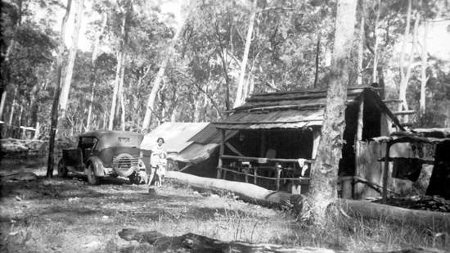
Burgess logging camp at Mt Beerwah (1940)

Slide 15
Ethel Burgess at the logging camp (1940)

Slide 16
Opening Mary Cairncross Park 1960

Slide 17
Mary Cairncross showing the bush and cleared land

