Slide 1
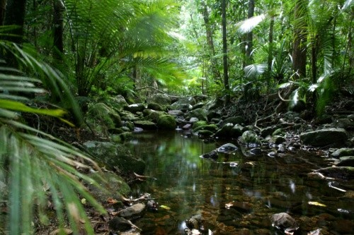
Layers of the Rainforest
Notes:
Hello Explorers! Welcome to the Rainforest!
It was a bumpy ride but we are finally here! The rainforest is not just a forest! It’s got 4 layers to it! It’s almost like 4 towns living right on top of one another!
The four layers consist of the forest floor, the understory, the canopy and the emergent layer. It’s important to know about these layers so that you know what animals and plants are lurking about!
Go learn about the layers Explorers! I’ll be here waiting when you turn!

Slide 2
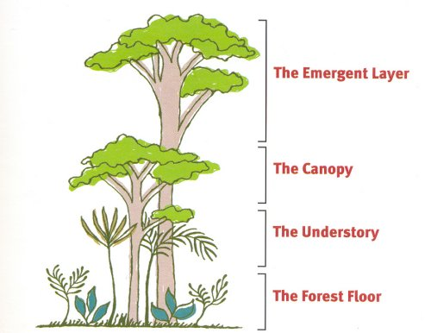
Four Layers of the Rainforest

Slide 3
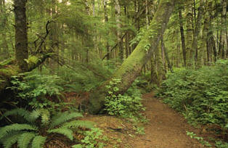
The Forest Floor
Characteristics:
Very dark and quiet
Covered with rotting leaves
Few ferns and bushes
Giant trunks of canopy trees

Slide 4
The Understory
Characteristics:
Dark place
Entwined with vines, shrubs, and broad leaves
Provides great camouflage
Species travel between the understory and the canopy
Many nocturnal species in this layer
Home to bats, red-eyed tree frogs, jaguars, etc.

Slide 5
The Canopy
Characteristics:
Primary life sustaining layer
Abundance of food
Forms a natural roof over the understory and forest floor
Home to many species, including Birds, Butterflies, Monkeys, Parrots, the slow moving sloth, Tree Frogs, Toucans, Jaguars and Leopard

Slide 6
The Emergent Layer
Characteristics:
Highest level of the rainforest
180 to 200 feet in height
Receives the most sunlight
A safe area for species to protect themselves from predators
Home to monkeys, birds, eagles, bats

Slide 7
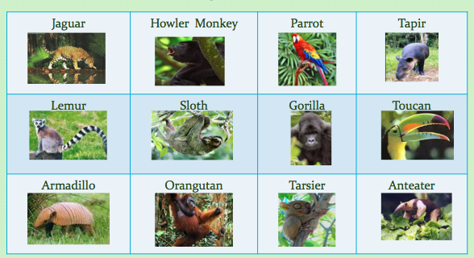
Animals in the Rainforest

Slide 8
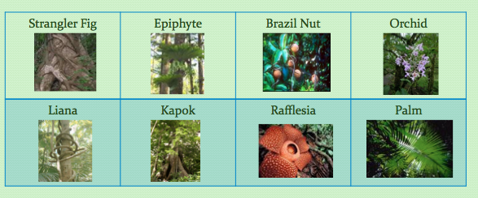
Plants of the Rainforest

